Slide 1

ALGEBRA EQ: $How do we solve equations using one step?$
Miss D’souza

Slide 2
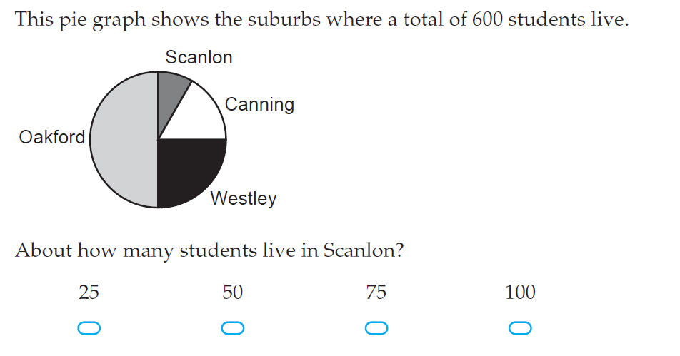

5 questions:
Find the mean, mode, range (45, 20, 41, 38, 42, 42, 48, 55)
Name one advantage and disadvantage of a Census
$3ab ×12a=$
Solve for $x$; $3x+5=20$
.

Slide 3

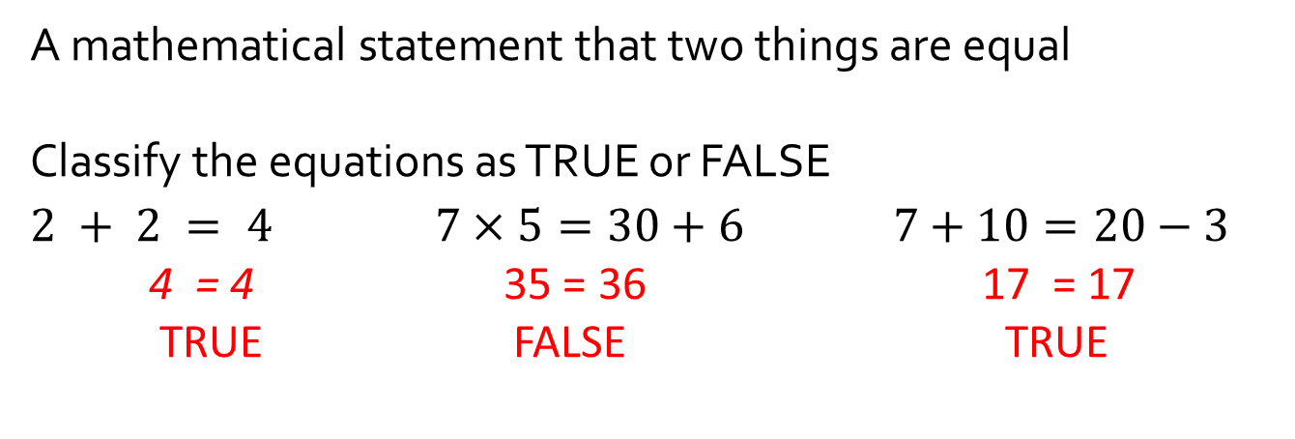
$$TOPIC: Algebra$$
$$EQ:How do we solve equations using one step?$$
What is an equation?
A mathematical statement that two things are equal
Classify the equations as TRUE or FALSE
$2 + 2 = 4$ $7×5=30+6 7+10=20−3$
4 = 4 35 = 36 17 = 17
TRUE FALSE TRUE
How do we find equivalent equations?
OPTION 1: Backtracking
OPTION 2: Balancing both sides

Slide 4








$$TOPIC: Algebra$$
$$EQ:How do we solve equations using one step?$$
How do we find equivalent equations?
OPTION 1: Backtracking
$$2x=24$$
$$×2$$
$$x$$
$$2x$$
$$12$$
$$24$$
+
$$−$$
$$÷2$$
×
÷

Slide 5




$$TOPIC: Algebra$$
$$EQ:How do we solve equations using one step?$$
How do we find equivalent equations?
OPTION 2: Balancing both sides
$$2x = 24$$
$$÷2$$
$$÷2$$
$$x =12$$
+
$$−$$
×
÷

Slide 6











I DO (LHS)
$$x+9=25$$
$$+ 9$$
$$x$$
$$x+9$$
$$x+9 = 25$$
$$−9$$
$$−9$$
$$16$$
$$25$$
$$x =16$$
$$−9$$

Slide 7



WE DO (LHS)
$$x−10=21$$
$$x$$
$$x−10 =21$$
$=$

Slide 8
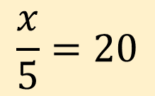
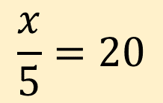
YOU DO (LHS)
$$\frac{x}{5}=20$$
$$\frac{x}{5}=20$$
$$x$$
$=$

Slide 9
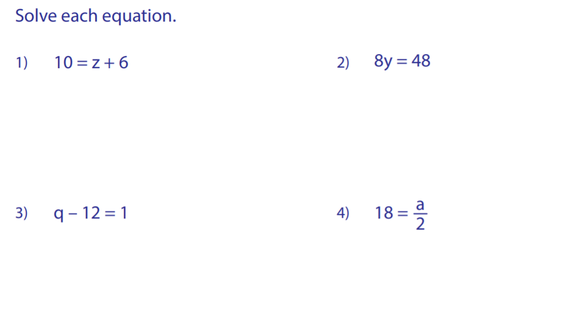
Answer the questions (only choose ONE option)

Slide 10
1) Complete the worksheet
2) Complete your SUMMARY

